Slide 1
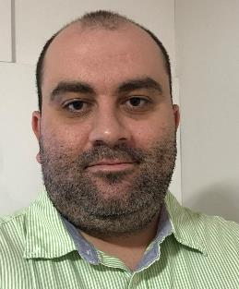







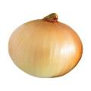

Éder David Borges da Silva, PhD
Plant breeding
Quantitative Genetics
Data Sciences
https://www.linkedin.com/in/ederdbs/
https://github.com/ederdbs
https://orcid.org/0000-0001-7121-0759
ederdbs@gmail.com / eder.silva@bayer.com
2006-2010
BSc Agronomy (UFPR)
2012
Started as Agronomic Data Specialist at Corteva
2013
Started Master Degree (UFSM)
2015
Finished Master
Started as Breeder Assistant at Corteva
2017-2018
2019-2021
Started as Breeder position
Finished Ph.D.
Applied ML in other areas
Started PhD (Unicentro)
Intensive use of genomic prediction
2022
Started Research Station Manager at Nutrien
2023-Courrent
Product development breeder for Sweet Corn and Onion Bayer

Slide 2
Vinicius

Slide 3
Rodrigo

Slide 4
Kaique

Slide 5
Rafael

Slide 6

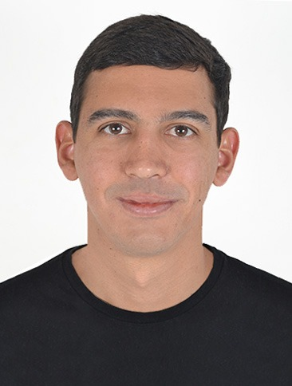






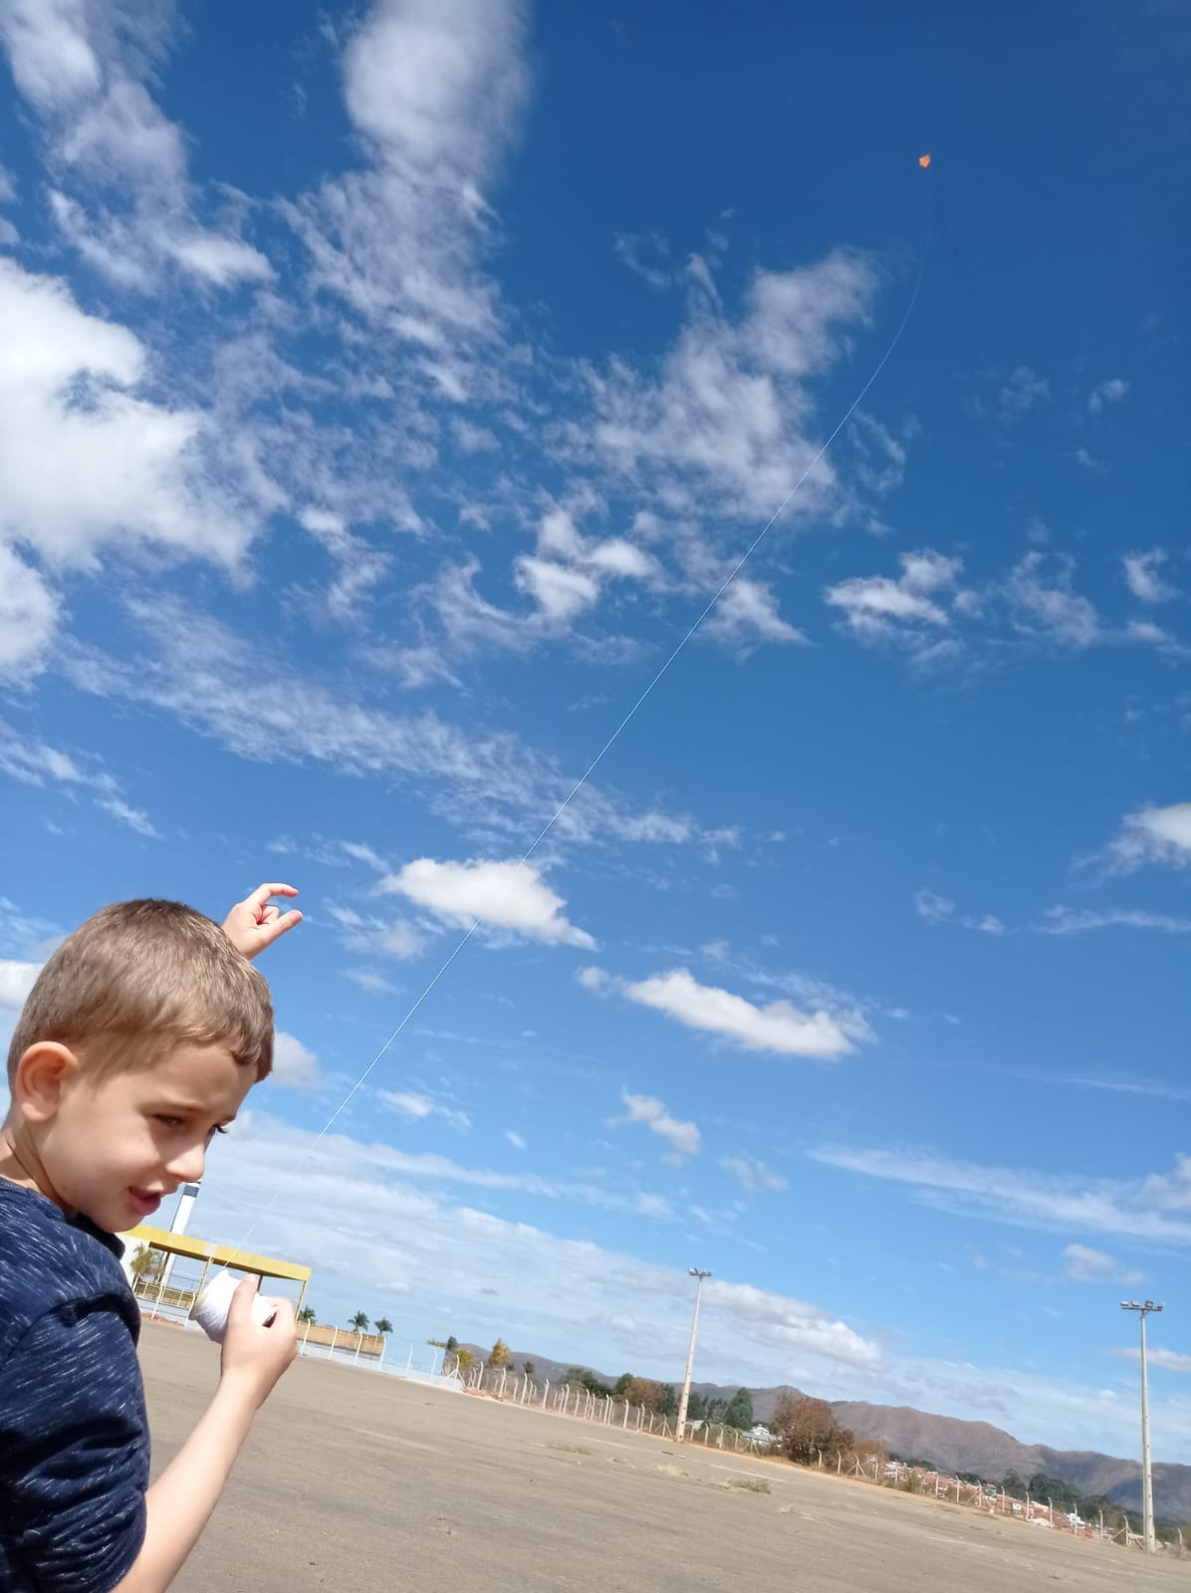
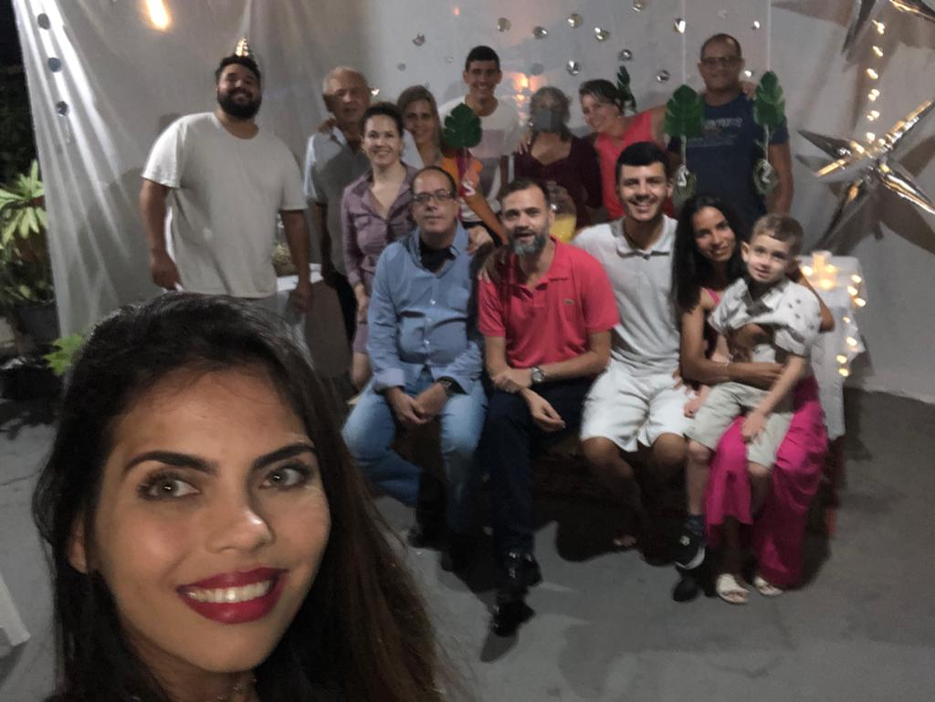
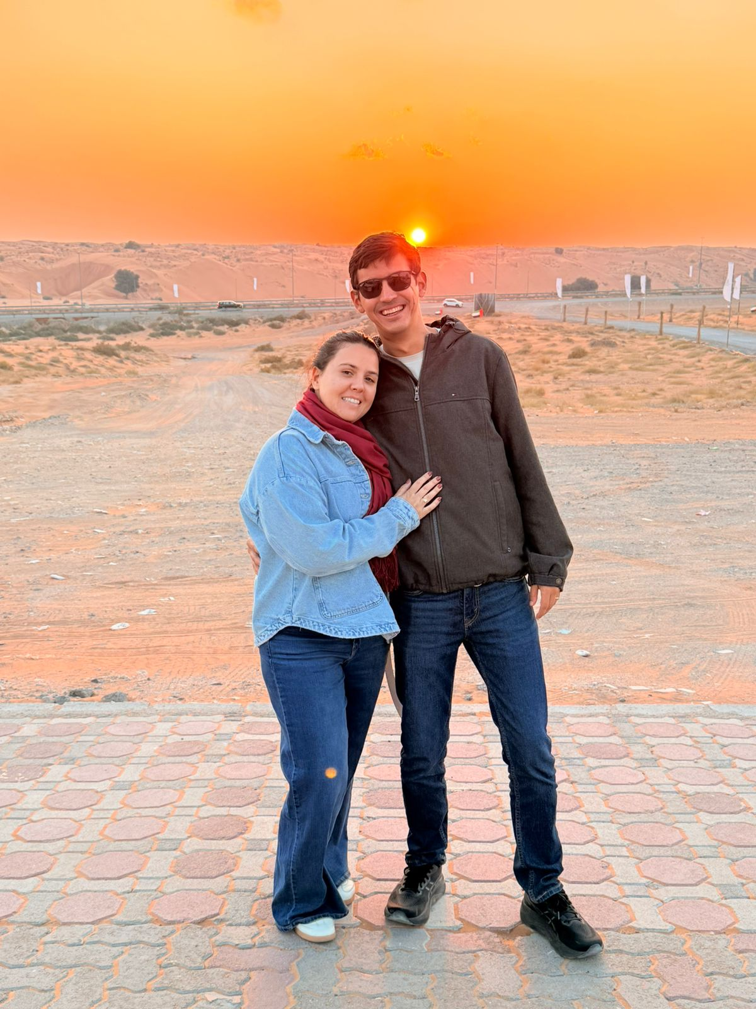
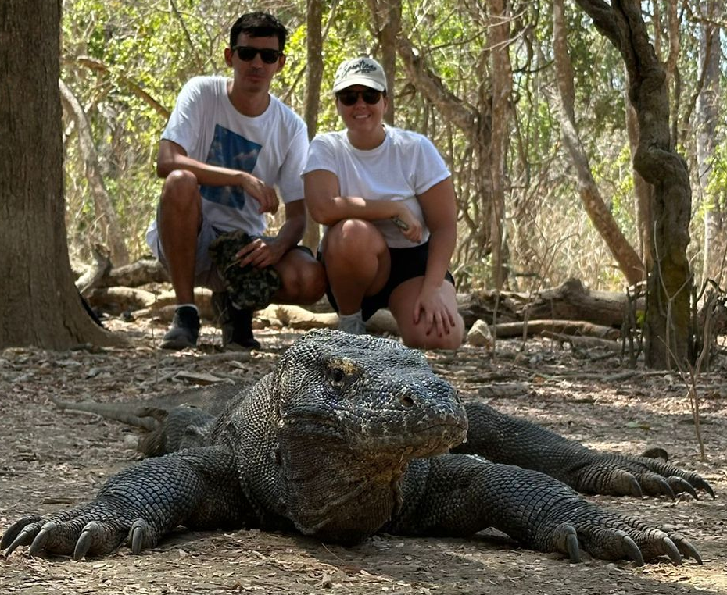
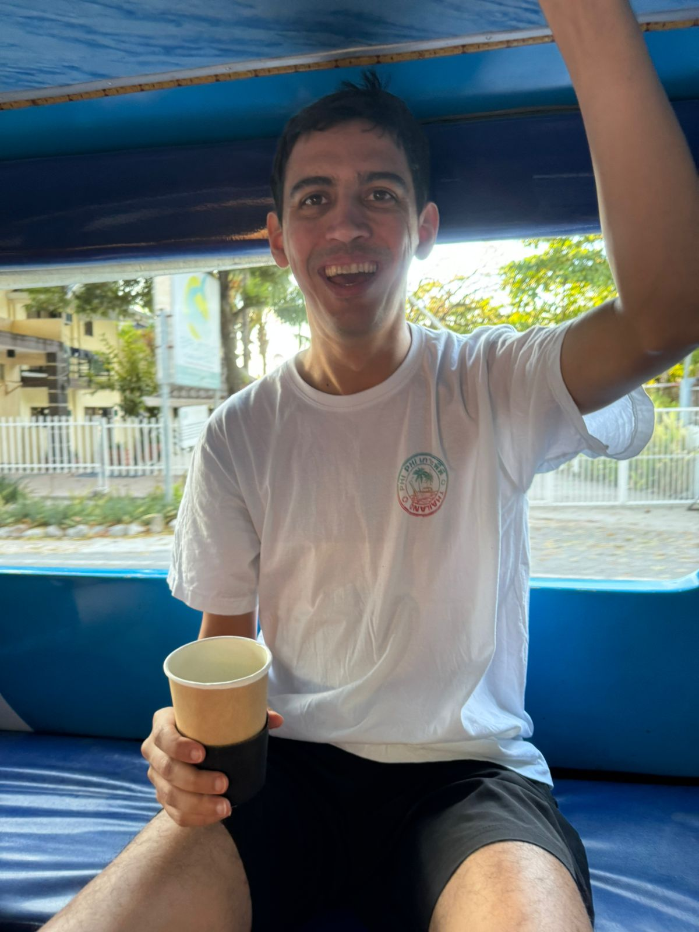
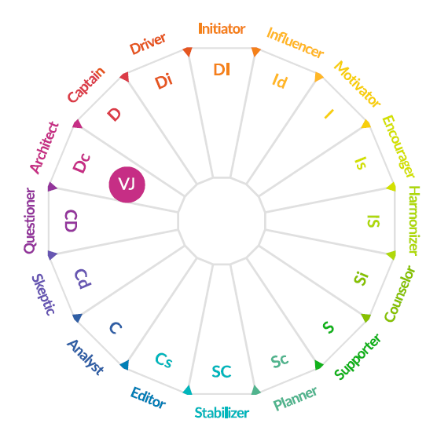

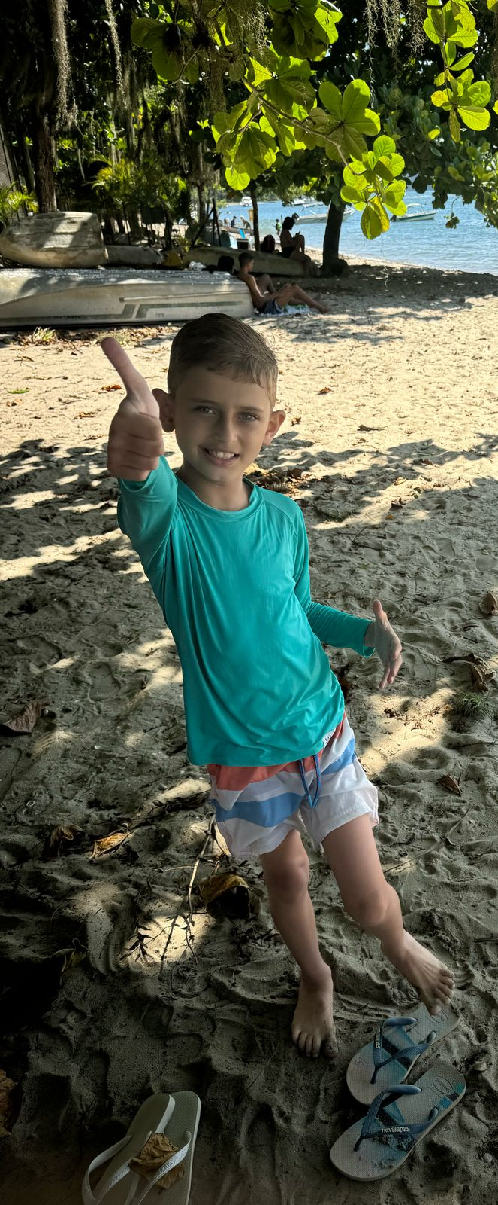
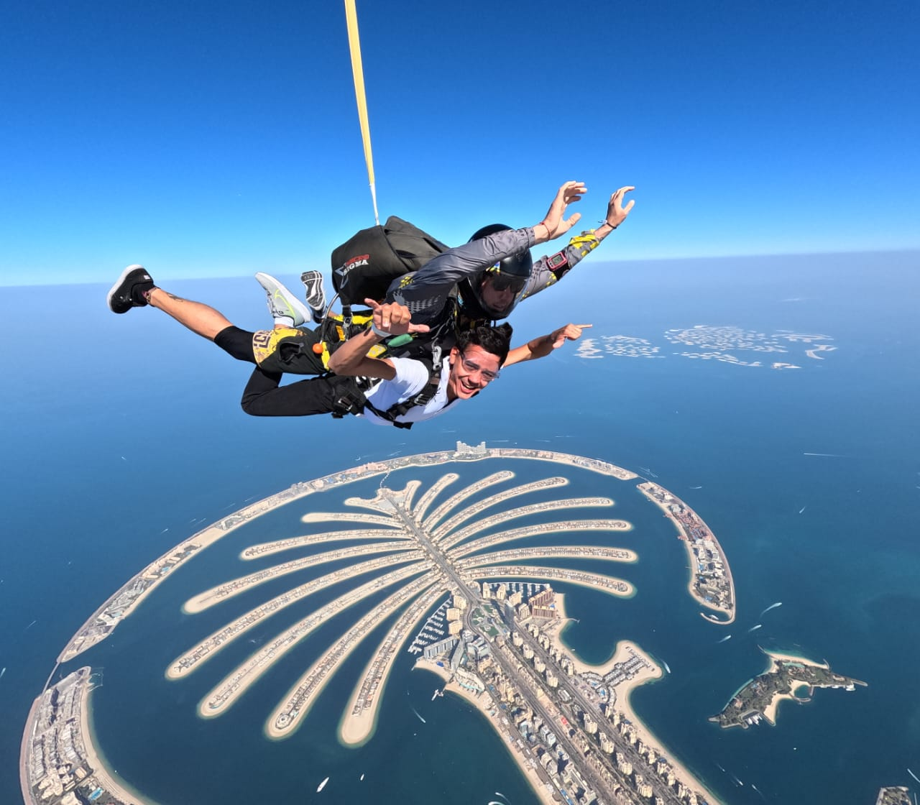

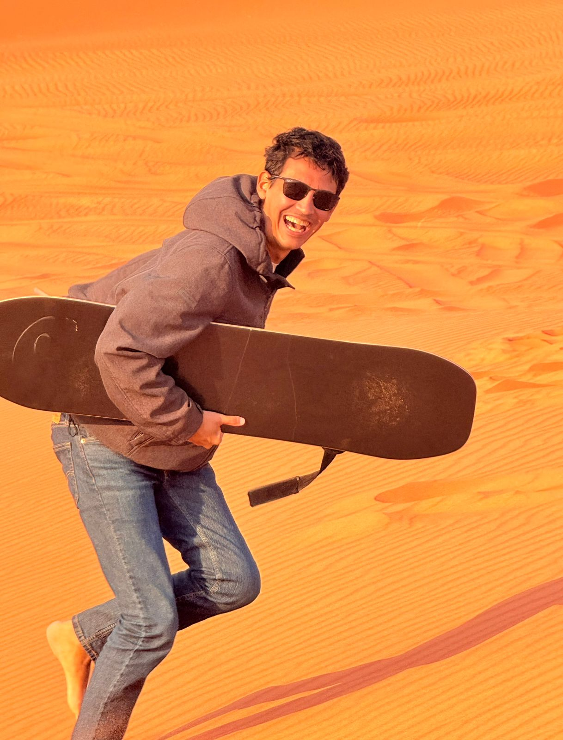
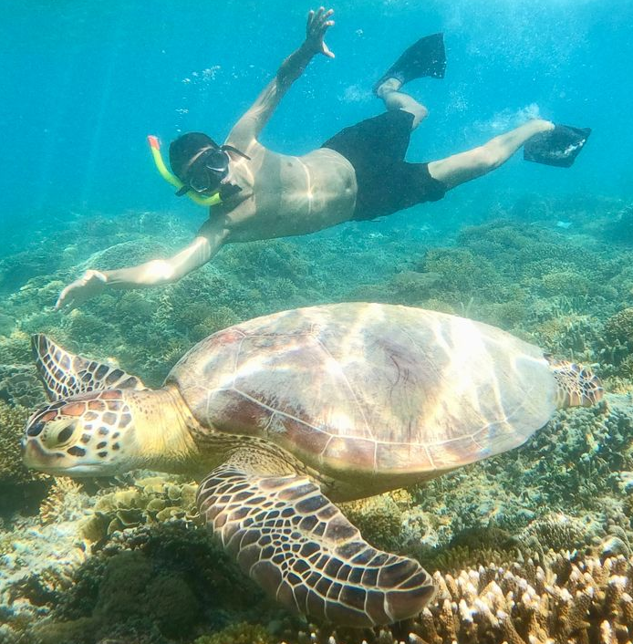
Vitor Passos
Product Design Scientist
Professional Experience:
Education:
2018 – Visiting Scholar at University of Florida
2019 – Senior Research in Eucalyptus Breeder;
2023 – Expert in Eucalyptus and Acacia Breeder;
2025 – Eucalyptus Breeding Coordinator
BS – Forest engineer
MSc & PhD – Quantitative Genetics
MBA – Leadership and Innovation
DISC: Dc
Architect
Efficient
Clear Communication
Maximizing efficiency everyday
Autonomy
I’ve combined scientific rigor with people development to drive impact in breeding programs.
  (picture)
My Family
My Travels
My Hobbies
My Competencies

